Slide 1


Team 20: 3-Phase Matrix Converter
Bi-Weekly Update 4 Chase Barnes, Daniel Loeza, Shanelle Algama Sponsor: Dr. John Lusher TA: Rhett Guthrie
Notes:
Michelle

Slide 2
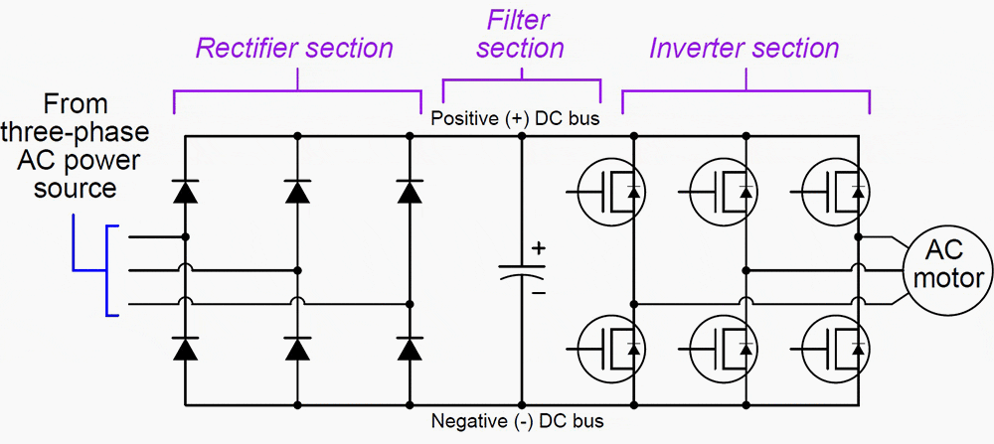
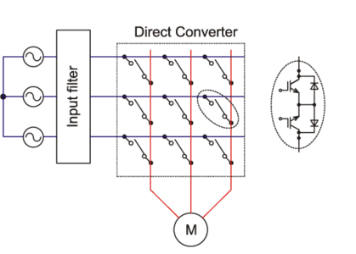
Project Summary
Traditional Variable Frequency Drives utilizes AC-DC-AC conversion:
Decreased efficiency across power output, and increased harmonic distortion.
3 Phase Matrix Converter utilizes AC-AC conversion:
Reduced efficiency loss across components.
Removes Electrolytic energy storage requirements
Notes:
Barnes

Slide 3
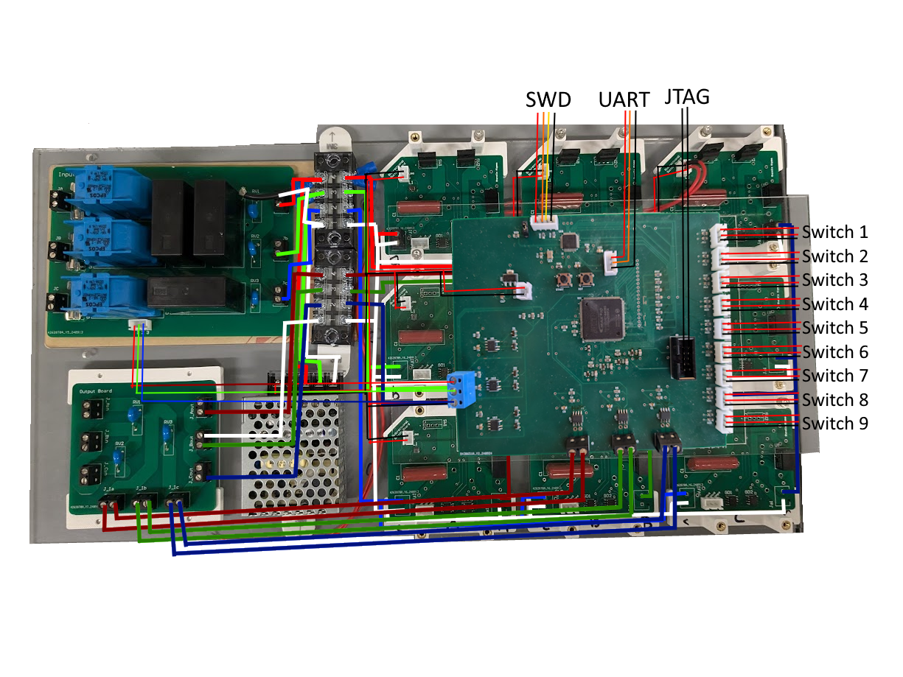
Integrated System Diagram
Notes:
TODO HAVE EVERYONE ELSE LOOK AT

Slide 4
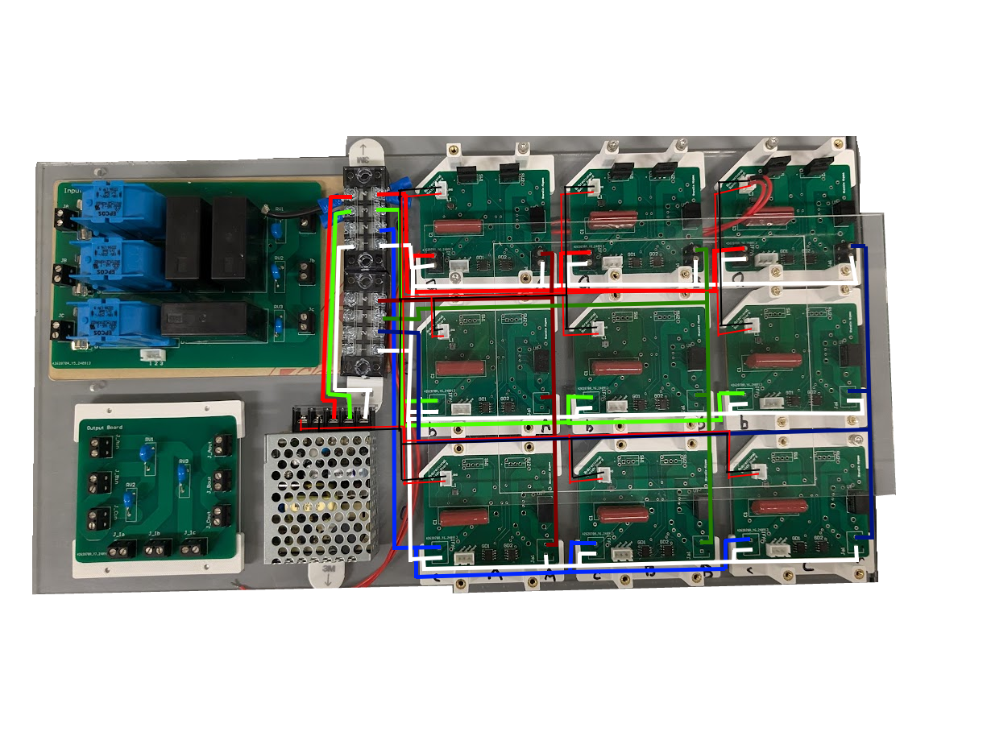
Integrated System Diagram
Notes:
Eric

Slide 5
Project Timeline
September 19 - Pulse Generator PCB will be assembled.
September 30 - Full Matrix of Bidirectional Switches will be assembled
October 7 - Pulse Generator Subsystem will be validated and functional.
October 10 - Firmware will be integrated with the Pulse Generator
October 14 - Matrix Converter Subsystem will be validated and functional
October 14 - Full System Integration will begin.
November 11 - System will be validated and functional.
November 21 - Final Demo
Notes:
Eric

Slide 6
Chase Barnes
Accomplishments since last update 35 hrs of effort | Ongoing progress/problems and plans until the next presentation
MC Flashed on pulse generator and functional 9/9 Bidirectional Switches Soldered Tested Input Filter Voltage reading for pulse generator zero crossing and found issues Input Filter and pulse generator sensor issues fix implemented Worked on validating Bidirectional switches and found issues | Finish getting FPGA implementation onto pulse generator Finish Crimping and wiring for Full Matrix Converter Integration Finish 3d printed mounting for input filter and pulse generator Verification and testing of the rest of the software integration, adding debugging features, timing verification

Slide 7
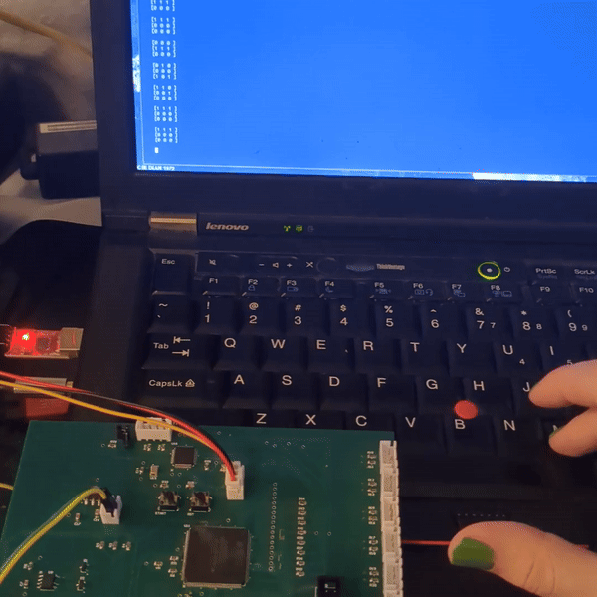
Chase Barnes

Slide 8
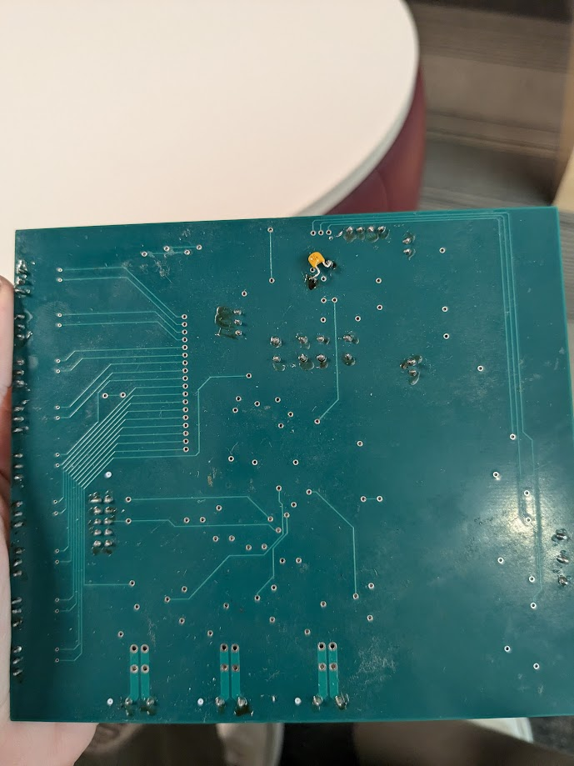
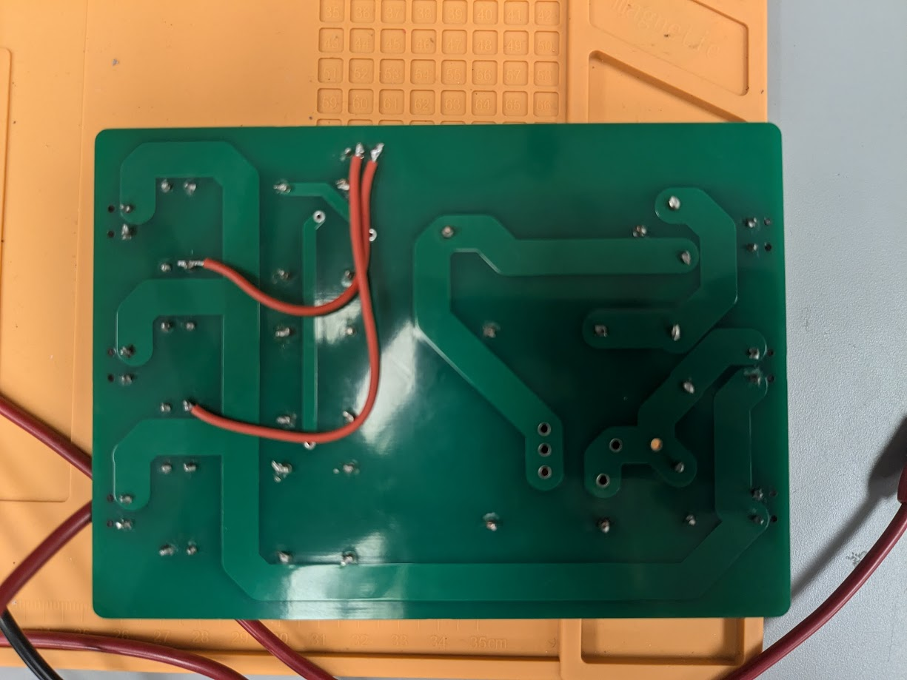
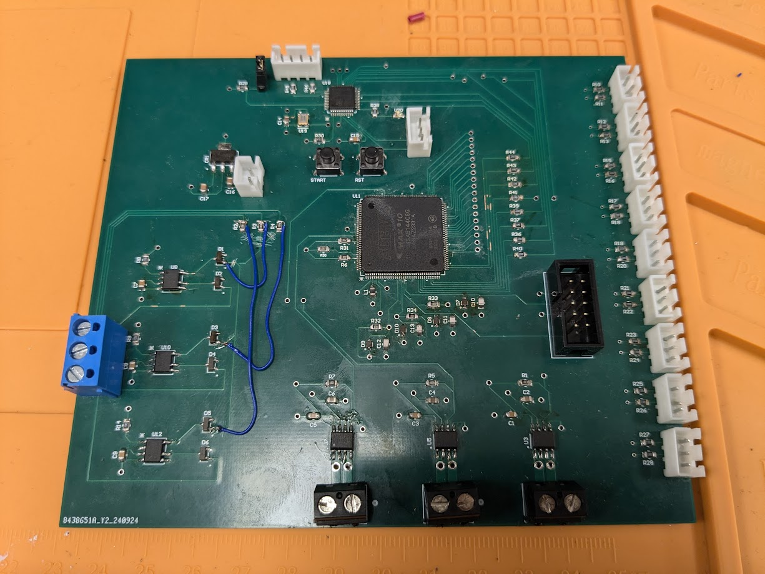
Chase Barnes

Slide 9
Shanelle Algama
Accomplishments since last update 8 hrs of effort | Ongoing progress/problems and plans until the next presentation
- Validation testing on Bidirectional switches -All bidirectional switches soldered -Trace Size and inductor on the DC-DC Converter might need to be adjusted | Some possible issues with validation on the switches, more testing will be need to be completed after fixing Meeting with Dr. Lusher soon to discuss Integration with Chase’s firmware

Slide 10
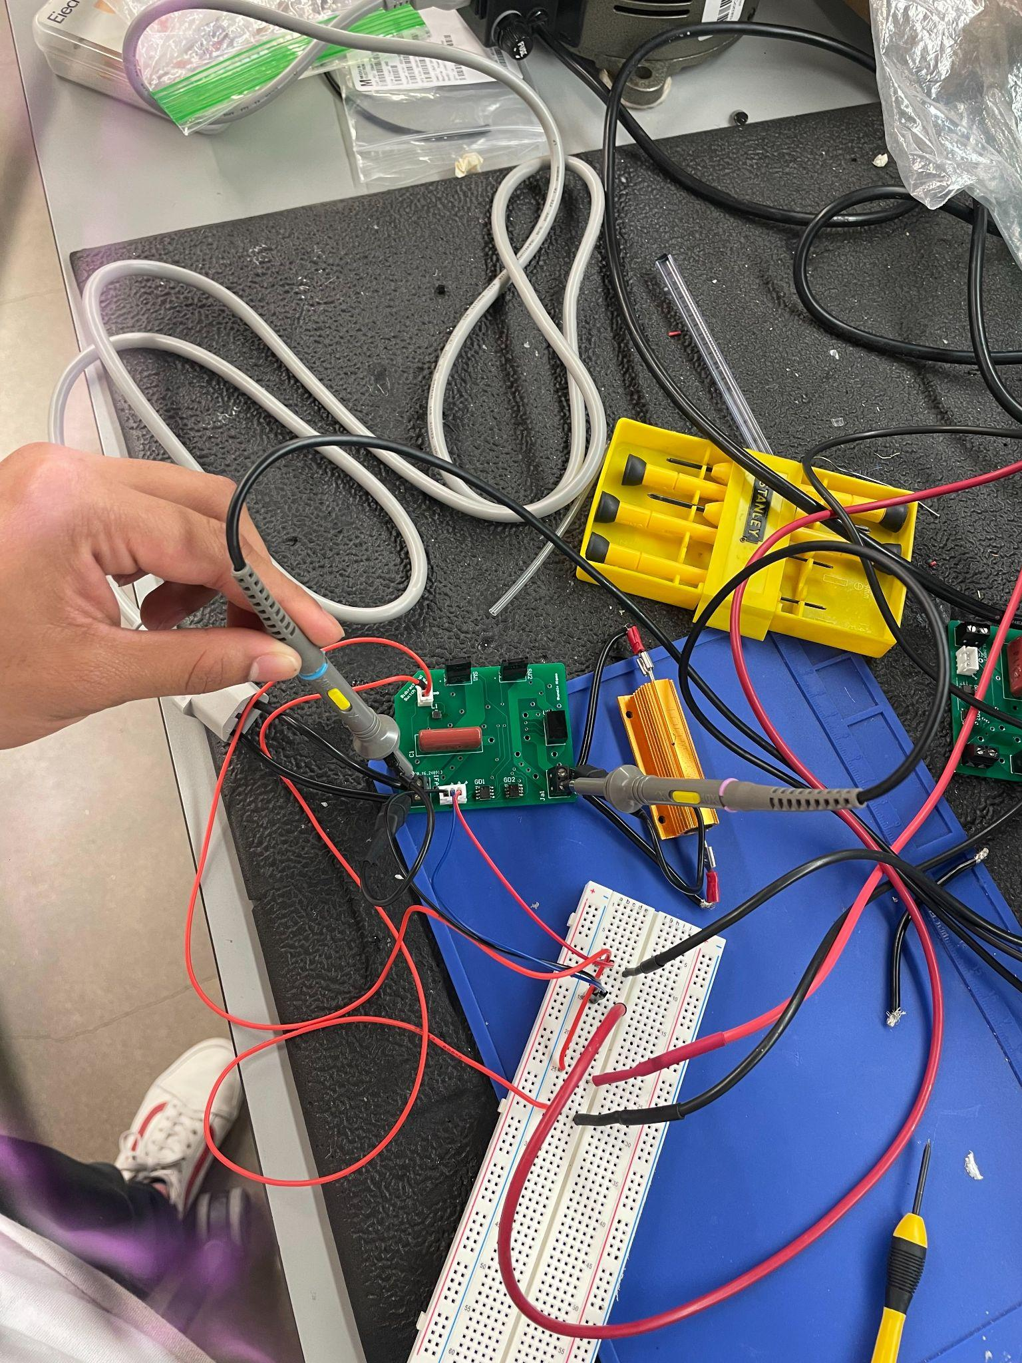
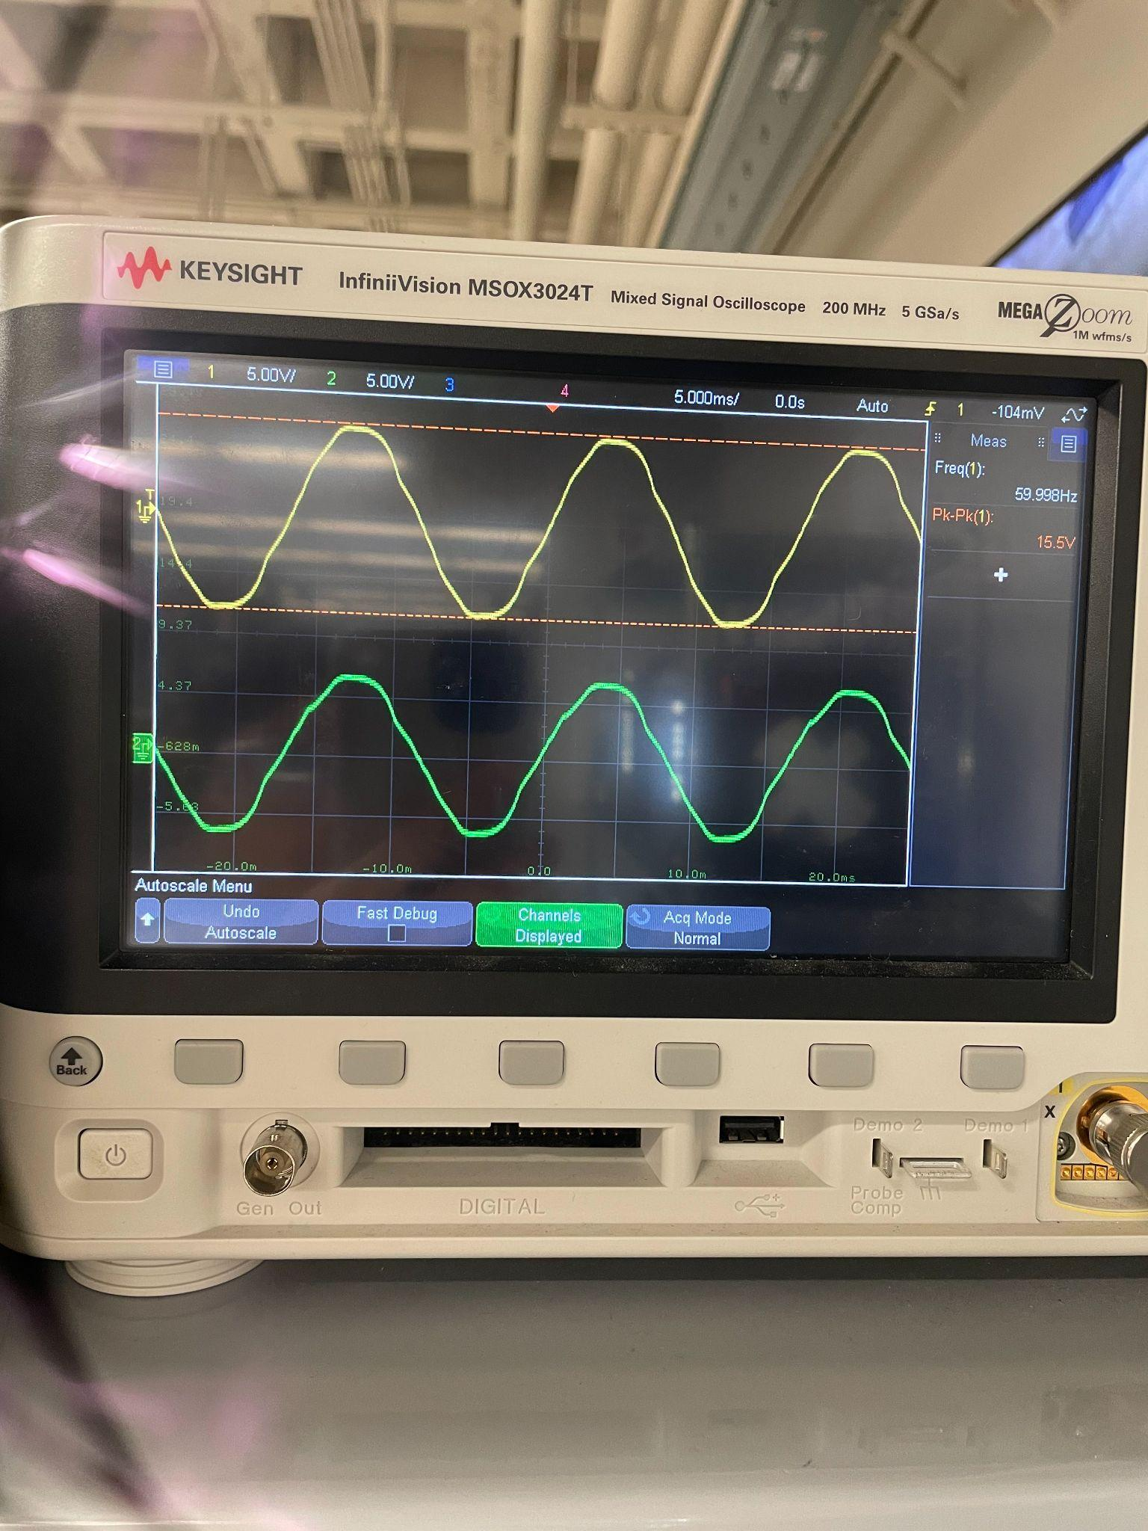
Shanelle Algama

Slide 11
Daniel Loeza
Accomplishments since last update 19 hrs of effort | Ongoing progress/problems and plans until the next presentation
Gained access to 3-phase power on third floor ZACH. Current sign sensors are valid. | Continue working with Chase on the integration of the Firmware and Pulse Generator Subsystem. Finish validating voltage crossing sensors now that we have access to 3-phase power. Begin integration with Matrix Converter subsystem Crimping all connectors for the system.

Slide 12
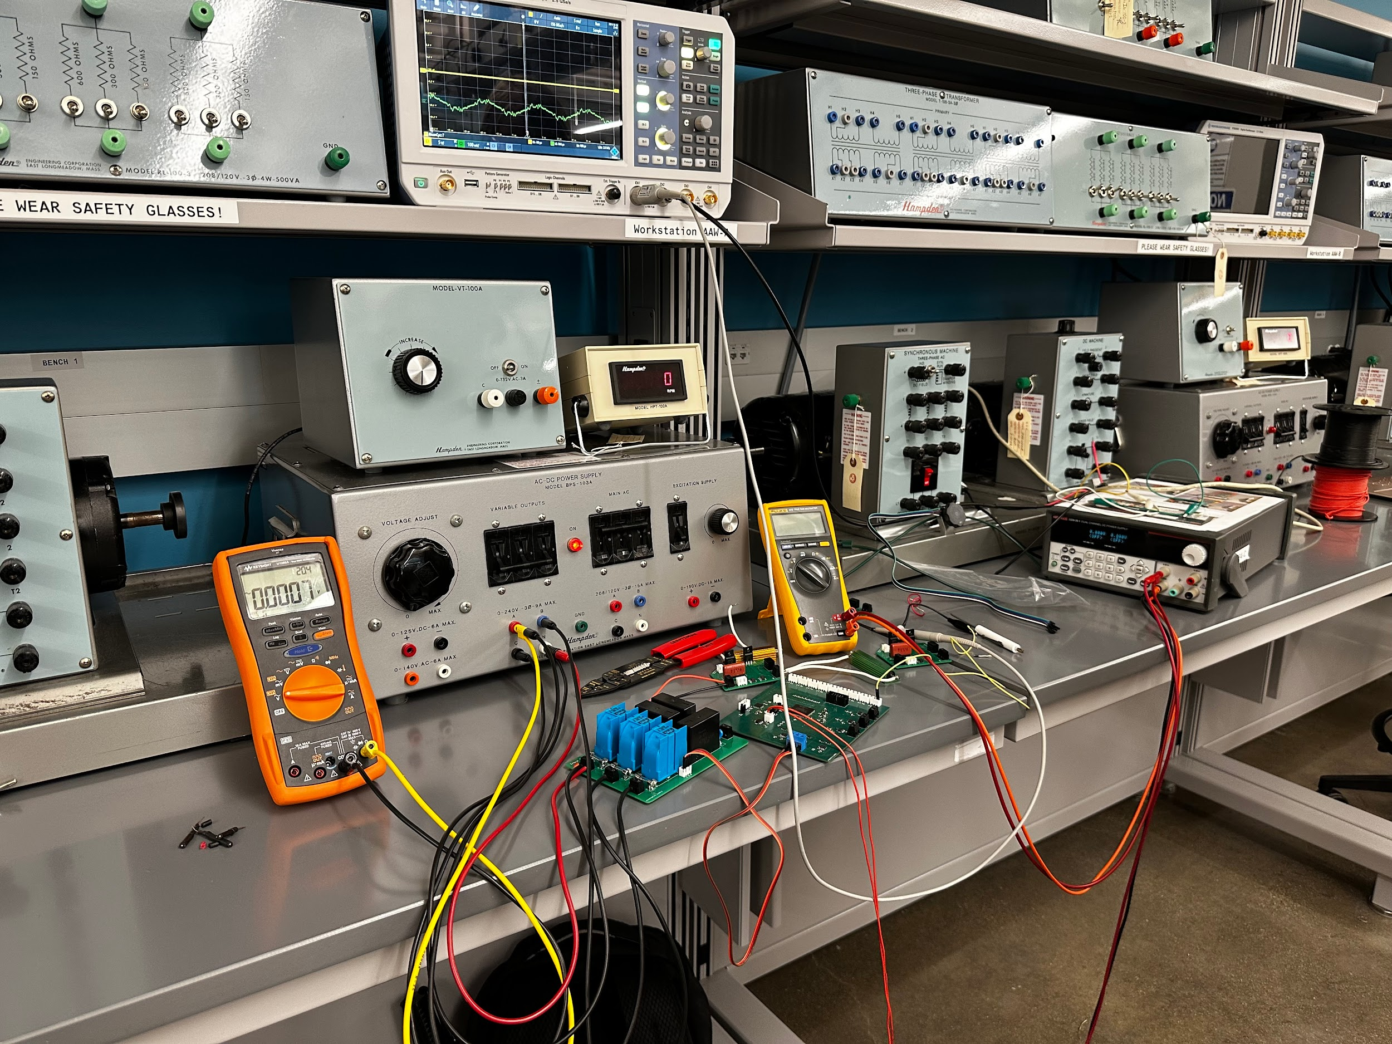
Daniel Loeza

Slide 13
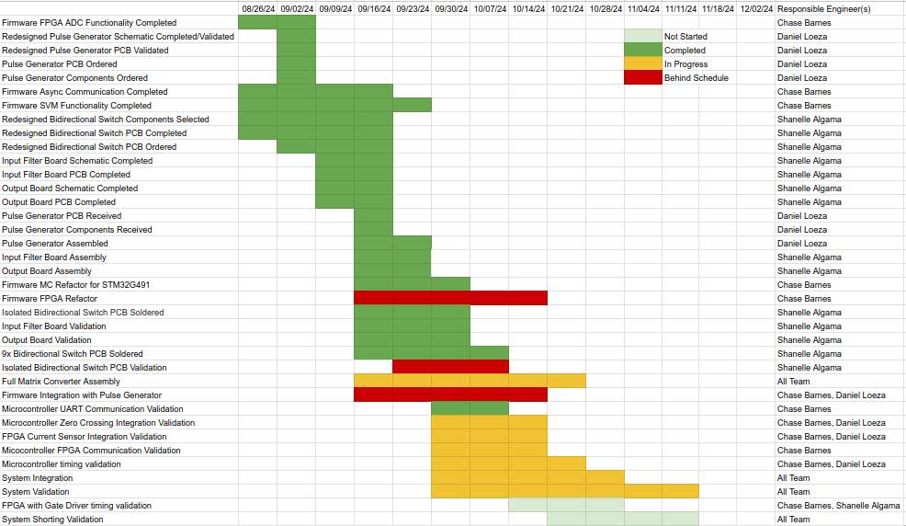
Execution Plan
Notes:
Michelle

Slide 14
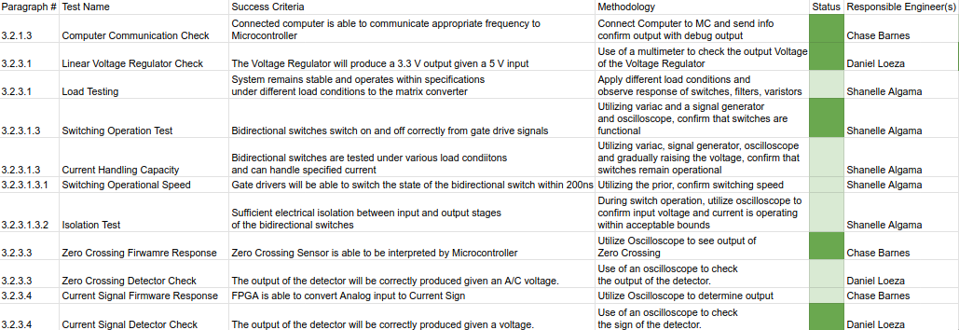
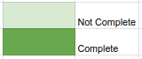
System Validation Plan
Notes:
Michelle

Slide 15
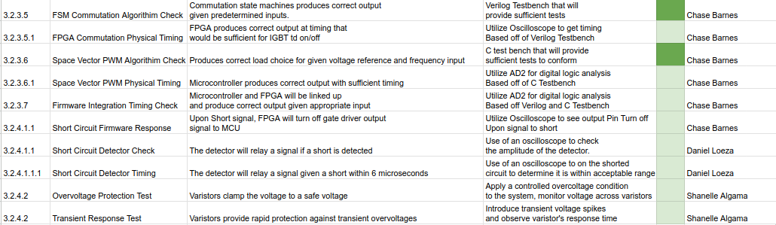
System Validation Plan
Notes:
Michelle

Slide 16
Thanks, and Gig ‘em!

